Slide 1
Juju + Puppet
Rapid harmonious deployment

Slide 2
Marc Cluet
Systems Integration Engineer
Canonical Ltd.
Adam Gandelman
Ubuntu Server Team
Canonical Ltd.

Slide 3
You've got the tools already
Hardware
Virtualization
Platform (OS)
Configuration Management
… need to tie that together into something whole.

Slide 4
Manages Services, not Machines
Devops Distilled
Notes:
We take your expertise and distill it into Juju Charms
Higher level than configuration management.
Only do things once, don't repeat yourself.
Don't repeat others.
Best practice out of the box.
Think of it like an API layer for your deployment.
No restriction on how you want to deploy

Slide 5
Elevate to Juju
Service
Orchestration
Configuration
Management
Virtualization
Operating
System
Hardware

Slide 6
Juju is
DevOps distilled.
Charms are a shareable, re-usable, and repeatable expressions of DevOps best practices. You can use them unmodified, or easily change and connect them to fit your needs. Deploying a formula is similar to installing a package on Ubuntu: ask for it and it’s there, remove it and it’s completely gone.

Slide 7
Juju is a community of DevOps expertise.
Most of the application you want will be available in Juju. Juju provides direct and free access to a DevOps community-contributed collection of formulas

Slide 8
Juju provides service orchestration.
Juju focuses on managing the service units you need to deliver a single solution, above simply configuring the machines or cloud instances needed to run them. Charms developed, tested, and deployed on your own hardware will operate the same in an EC2 API compatible cloud.

Slide 9
Juju is intelligent.
Juju exposes re-usable service units and well-defined interfaces that allow you to quickly and organically adjust and scale solutions without repeating yourself.

Slide 10
Juju is easy.
There’s no need to learn a domain specific language (DSL) to use Juju or create formulas. You can be up and running with your own formula in minutes.

Slide 11
Orchestrates provisioning (EC2, OpenStack, Bare Metal)
Write your formulas in whatever language you want.

Slide 12
Charms
Reusable, codified best-practice.
Distilled deployment expertise.
Communication via interfaces.
Doesn't require foreknowledge of who will use them or how

Slide 13









~40 formulas

Slide 14
Relating services
Notes:
Deployment is easy, a big deal problem, lots of VC there.
BUT You're not done!!!! This is where the meat is.
You don't need to spend all this time investigating how the different parts fit together.
And test it fucking around, just get it done.

Slide 15
Relations
A high-level interface describing the interactions between services
Services have `provides` and `requires` interfaces
Juju models the relationship between services, not machines

Slide 16
Scaling services

Slide 17
Services
Services change during their lifetime:
Number of instances?
Which machines they run on?
What services they depend on?
And how those services are implemented?

Slide 18
$ juju bootstrap
$ juju deploy hadoop-master
$ juju deploy hadoop-slave
$ juju add-relation hadoop-master hadoop-slave
$ juju add-unit hadoop-slave

Slide 19
$ juju bootstrap
$ juju deploy hadoop-master
$ juju deploy hadoop-slave
$ juju add-relation hadoop-master hadoop-slave
$ juju add-unit hadoop-slave
$ juju add-unit hadoop-slave

Slide 20
$ juju bootstrap
$ juju deploy hadoop-master
$ juju deploy hadoop-slave
$ juju add-relation hadoop-master hadoop-slave
$ juju add-unit hadoop-slave
$ juju add-unit hadoop-slave
$ juju add-unit hadoop-slave

Slide 21

Juju
Juju treats individual services as atoms that are described as formulas and can be instantiated one or many times.
Juju environment
Cloud app
Cloud app
Cloud app
and dependency solver

Slide 22
Juju
Load
Balancer
HAProxy
Each formula (or atom) define dependencies and/or provides.
Depends
Provides
Juju environment
Cloud app
Cloud app
Cloud app
and dependency solver
Provides
Depends
SQL Database
MySQL

Slide 23
Juju
Load
Balancer
HAProxy
Varnish
Multiple formulas can provide the same service and can be easily switched.
Depends
Provides
Juju environment
Cloud app
Cloud app
Cloud app
and dependency solver
Provides
Depends
SQL Database
MySQL

Slide 24
Juju
Varnish
Varnish
Juju maintains the relations between the services so that you don't need to care about the elasticity of your environment.
Relations are to formulas what bounds are to atoms.
Services are loosely coupled but highly cohesive.
Juju Relation
Juju environment
Cloud app
Cloud app
Cloud app
and dependency solver
Juju Relation
MySQL
MySQL
MySQL

Slide 25
Juju
Varnish
Juju maintains the relations between the services so that you don't need to care about the elasticity of your environment.
Relations are to formulas what bounds are to atoms.
Services are loosely coupled but highly cohesive.
Juju Relation
Juju environment
Cloud app
Cloud app
Cloud app
and dependency solver*
Juju Relation
MySQL
MySQL
*coming soon

Slide 26
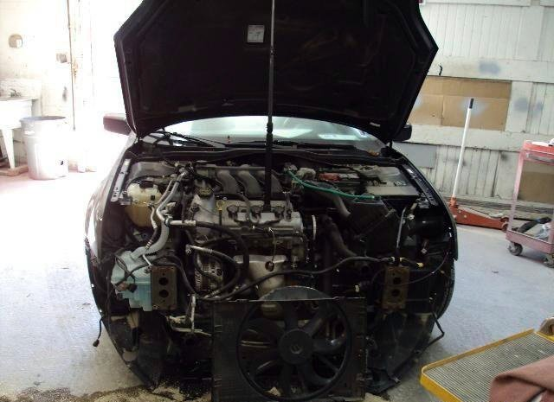
Juju Under the Hood

Slide 27
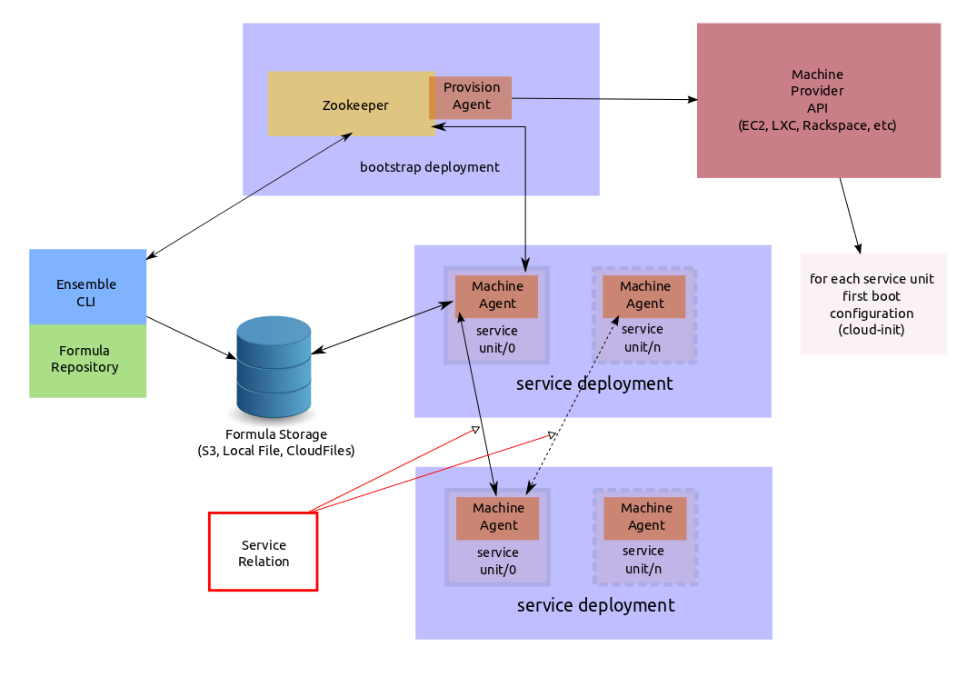

Slide 28


Juju + Puppet

Slide 29
Strong Points
Juju
Linear deployment
Relationship bonding
High level scope
Deployment consistent
Puppet
Rapid templating
Smart dependencies
Very good at low level
Continuous consistency

Slide 30
Weak Points
Juju
Config Templating
Sync
Puppet
High level dependencies
Async

Slide 31
Juju + Puppet
Best of both worlds!
Juju gives high level scope
Juju accepts charms in any language
Puppet is very good at system templating
We can use puppet DSL in charms

Slide 32
Juju + Puppet
SCENARIO 1
Juju for app deploy + puppetmaster

Slide 33
Juju
Hadoop-master
Juju environment
Puppetmaster
Puppetmaster
Hadoop-slave
Hadoop-slave
Hadoop-slave
Hadoop-slave
Hadoop-slave
and dependency solver

Slide 34

DOES THIS WEBSCALE?

Slide 35
Juju
HA Proxy
Hadoop-master
Juju environment
Puppetmaster
Puppetmaster
+ nginx
Hadoop-slave
Pupetmaster
+ nginx
Hadoop-slave
Hadoop-slave
Hadoop-slave
Hadoop-slave
and dependency solver
MySQL

Slide 36
Juju + Puppet
SCENARIO 2
Juju for app deploy + puppet standalone

Slide 37
Juju
Varnish
Puppet
Juju Relation
Juju environment
Cloud app
Puppet
and dependency solver
Juju Relation
MySQL
Puppet

Slide 38
All development is public
Communication is open
Join Us
IRC: #juju on irc.freenode.net
Launchpad: https://launchpad.net/juju
Web: https://juju.ubuntu.com/

Slide 39

QUESTIONS?

Slide 40
juju.ubuntu.com

